Slide 1
Data Structures
9 Lecture – Tree
Go to the link for course materials:
https://drive.google.com/open?id=0B88ti1PlrP6qRjVmSkxsOXJGcXM

Slide 2
Content
Tree Data Structure and its applications
Terminologies of a Tree
Binary Tree
Complete and Full Binary Tree
Balanced tree
  Traversing a Tree
  Inorder / preorder / postorder

Slide 3
Tree Data Structures
There are a number of applications where linear data structures are not appropriate.
Consider a genealogy tree of a family.
Mohammad Aslam Khan
Sohail Aslam
Javed Aslam
Yasmeen Aslam
Haaris
Saad
Qasim
Asim
Fahd
Ahmad
Sara
Omer

Slide 4
Common use of Tree data structure
Representing hierarchical data
Storing data in a way that makes it easily searchable
Representing sorted lists of data
As a workflow for compositing digital images for visual effects
Routing algorithms

Slide 5
Definition of Tree Data Structure:
As a data structure, a tree is a group of nodes, where each node has a value and a list of references to other nodes (its children nodes).
A
B
C
D
E
F
G
H
I

Slide 6
Not a Tree
Structures that are not trees.
A
B
C
D
E
F
G
H
I

Slide 7
Not a Tree
Structures that are not trees.
A
B
C
D
E
F
G
H
I

Slide 8
Not a Tree
Structures that are not trees.
A
B
C
D
E
F
G
H
I

Slide 9
Parts of a Tree

Slide 10
Parts of a Tree
nodes

Slide 11
Parts of a Tree
parent node

Slide 12
Parts of a Tree
parent node
child nodes

Slide 13
Parts of a Tree
parent node
child nodes

Slide 14
Parts of a Tree
root node

Slide 15
Parts of a Tree
leaf nodes

Slide 16
Parts of a Tree
sub-tree

Slide 17
Parts of a Tree
sub-tree

Slide 18
Parts of a Tree
sub-tree

Slide 19
Parts of a Tree
sub-tree

Slide 20
m-array Trees
A Tree is an m-array Tree when each of its node has no more than m children.
a
d
64
b
c
e
56
89
g
i
f
h
j
k
47
59
l
m
n
o
p
Three-array trees
(m=3)
Two-array trees
(m=2)

Slide 21
Binary Tree (BT)
Each node can have at most 2 children

Slide 22
Binary Tree
Binary tree with 9 nodes.
A
B
C
D
E
F
G
H
I

Slide 23
Binary Tree
root
A
B
C
D
E
F
G
H
I
Left subtree
Right subtree

Slide 24
Binary Tree
Recursive definition
A
root
B
C
D
E
F
Left subtree
G
H
I
Right subtree

Slide 25
Binary Tree
Recursive definition
A
B
C
root
D
E
F
G
H
I
Left subtree

Slide 26
Binary Tree
Recursive definition
A
B
C
D
E
F
root
G
H
I

Slide 27
Binary Tree
Recursive definition
A
root
B
C
D
E
F
G
H
I
Right subtree

Slide 28
Binary Tree
Recursive definition
A
B
C
root
D
E
F
G
H
I
Left subtree
Right subtree

Slide 29
Level & Depth of a Binary Tree
The level of a node in a binary tree is defined as follows:
  Root has level 0,
  Level of any other node is one more than the level its parent (father).
The depth of a tree means how many levels is in the tree i.e. the Total number of level in the tree.

Slide 30
Level of a Binary Tree Node
A
0
Level 0
B
1
C
1
Level 1
D
E
F
2
Level 2
2
2
G
H
3
I
3
Level 3
3

Slide 31
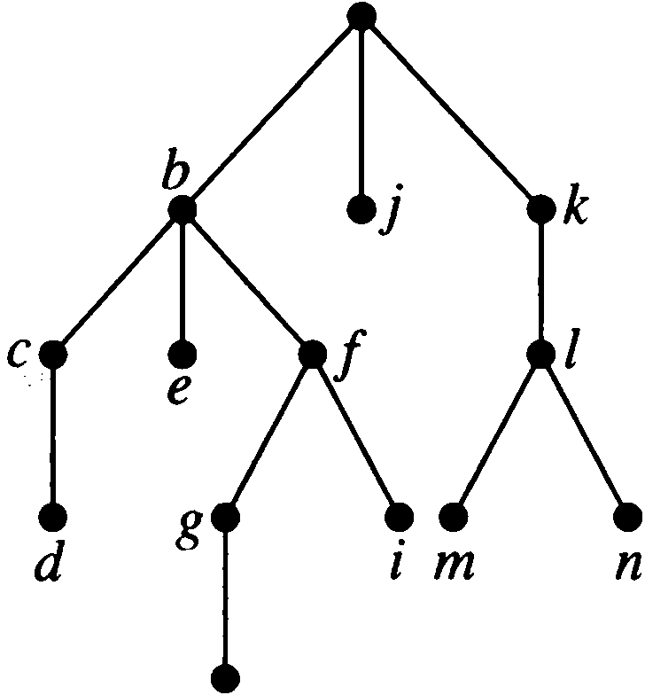
Find the level of each node in the tree shown in Figure.
What is the height/depth of this tree?
a
The root a is at level O.
Nodes b, j, and k are at level 1 .
Nodes c, e, f, and I are at level 2.
Nodes d, g, i , m , and n are at level 3 .
Finally, Node h is at level 4.
The height/depth of this tree is 4.
The height of node b is 1.
The height of node h is 4.
The depth of node m is 3.
h

Slide 32
Complete Binary Tree
A complete binary tree is a binary tree, which is completely filled, with the possible exception of the bottom level, which is filled from left to right.
A
0
B
1
C
2
D
3
E
4
F
5
G
6
H
I
J
K
L
8
9
10
11
12
Top to bottom,
From left to right number

Slide 33
Full Binary Tree
A full binary tree of depth k is a binary tree of depth k having 2^{k} -1 nodes, k>=0.
A
Level 0: 2⁰ = 1 nodes
B
C
Level 1: 2¹ = 2 nodes
D
E
F
G
Level 2: 2² = 4 nodes
H
I
J
K
L
M
N
O
Level 3: 2³ = 8 nodes
Here depth is k = 4 and Total nodes (2⁴ -1) = 15

Slide 34
Full BT VS Complete BT
A full binary tree of depth k is a binary tree of
depth k having 2^{k} -1 nodes, k>=0.
A binary tree with n nodes and depth k is complete iff its nodes correspond to the nodes numbered from 0 to n-1 in the full binary tree of depth k..
Top to bottom,
From left to right number
A
A
B
C
B
C
D
E
F
G
D
E
F
G
H
H
I
J
K
L
M
N
O
Complete binary tree
Full binary tree of depth 4

Slide 35
Traversal
Systematic way of visiting all the nodes.
Methods:
  Inorder
  Postorder
  Preorder
They all traverse the left subtree before the right subtree.
The name of the traversal method depends on when the node is visited.

Slide 36
Inorder Traversal (Lfet_Node_Right)
Traverse the left subtree.
Visit the node.
Traverse the right subtree.
a
b
c
b
a
c

Slide 37
Inorder Example
a
b
c
f
d
e
g
j
h
i
g
d
h
b
e
i
a
f
j
c

Slide 38
Postorder Traversal (Lfet_Right_Node)
Traverse the left subtree.
Traverse the right subtree.
Visit the node.
a
b
c
b
c
a

Slide 39
Postorder Example
a
b
c
f
d
e
g
j
h
i
g
h
d
i
e
b
j
f
c
a

Slide 40
Preorder Traversal (Node_Lfet_Right)
Visit the node.
Traverse the left subtree.
Traverse the right subtree.
a
b
c
a
b
c

Slide 41
Preorder Example
a
b
c
f
d
e
g
j
h
i
a
b
d
g
h
e
i
c
f
j
Notes:
During the traversal, t starts at the root, moves to the left child b of the root, then to the left child d of b. When the traversal of the left subtree of b is complete, t, once again, points to the node b. The t moves into the right subtree of b. When the traversal of this right subtree is complete, t again points to b. Following this, t points to a. We see that t points to every node in the binary tree three times – once when you get to the node from its parent (or in the case of the root, t is initially at the root), once when you return from the left subtree of the node, and once when you return from the node’s right subtree. Of these three times that t points to a node, the node is visited the first time.

Slide 42
Example: Inorder
43
31
64
20
40
56
89
28
33
47
59
20
28
31
33
40
43
47
56
59
64
89

Slide 43
Example: Postorder
43
31
64
20
40
56
89
28
33
47
59
28
20
33
40
31
47
59
56
89
64
43

Slide 44
Example: Preorder
43
31
64
20
40
56
89
28
33
47
59
43
31
20
28
40
33
64
56
47
59
89

Slide 45
Some Examples
preorder ab
a
a
b
b
inorder
ab
b
a
a
b
postorde ab
b
b
a
a

Slide 46
Exercise:
Find the sequences for Preorder, Inorder and Postorder Traversal
a
d
b
c
e
i
g
f
h
j
k
l
m
n
o
p

Slide 47
Answer:
Preorder: a b e j k n o p f c d g l m h i
Inorder: j e n k o p b f a c l g m d h i
Postorder: j n o p k e f b c l m g h i d a
Dr. Kazi A Kalpoma

Slide 48
Inorder Traversal (recursive version)
A / B * C * D + E
void inorder(TreeNode *ptr)
{
if (ptr!=NULL) {
inorder(ptr->left);
cout << ptr->data;
indorder(ptr->right);
}
}
+
*
E
*
D
/
C
A
B

Slide 49
Postorder Traversal (recursive version)
A B / C * D * E +
void postorder(TreeNode *ptr)
{
if (ptr!=NULL) {
postorder(ptr->left);
postdorder(ptr->right);
cout << ptr->data;
}
}
+
*
E
*
D
/
C
A
B

Slide 50
Preorder Traversal (recursive version)
+ * * / A B C D E
void preorder(TreeNode *ptr)
{
if (ptr!=NULL) {
cout << ptr->data;
preorder(ptr->left);
predorder(ptr->right);
}
}
+
*
E
*
D
/
C
A
B

